Slide 1
View Resolvers & Views & Upload & Exceptions & Internationalization
& Tiles
Harmonizing Diversity

Slide 2
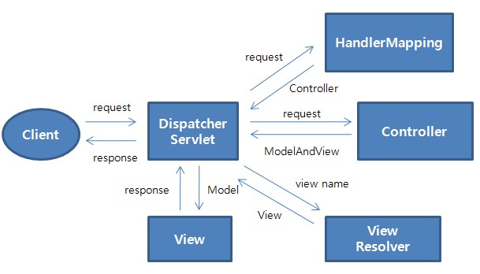
Spring MVC Flow

Slide 3
Spring MVC View Resolvers
Flexible View Resolving Mechanism
Resolve logical String-based view names to View types.
Many out-of-the-box implementations[examples]:
UrlBasedViewResolver-This directly resolves a view name to a URL without any explicit mapping. The view names can be the URL themselves or a prefix or suffix can be added to get the URL from the view name.
InternalResourceViewResolver-This is a subclass of
UrlBasedViewResolver. Out-of-the-box support for JSP
FreeMarkerViewResolver-This is a subclass of UrlBasedViewResolver that supports FreeMarkerView and its subclasses.
VelocityViewResolver-This is a subclass of UrlBasedViewResolver that supports VelocityView and its subclasses.
ContentNegotiatingViewResolver-This is an implementation of a view resolver based on the request file name or Accept header – mime-type. This class delegates view resolution to other view resolvers that are configured.

Slide 4
Multiple View Resolvers Configuration
<!-- lower order value has a higher priority -->
<bean id=“internalViewResolver“
class="org.springframework.web.servlet.view.InternalResourceViewResolver">
<property name="prefix" value="/WEB-INF/views/" />
<property name="suffix" value=".jsp" />
<property name="order" value="3" />
</bean>
<bean id="viewResolver“
class="org.springframework.web.servlet.view.freemarker.FreeMarkerViewResolver“>
<property name="prefix" value=""/>
<property name="suffix" value=".ftl"/>
<property name="order" value="2" />
</bean>
See webstoreFreVelTym
Notes:
TEMPLATES:
Java and SQL code generation
XML processing and transformation
Text processing, such as RTF file generation

Slide 5
Spring MVC Views
Spring has flexible view support through the View Interface class
Out-of-the-box view support for:
  JspView - InternalResourceViewResolver
  JSON - ContentNegotiatingViewResolver **
  XML - ContentNegotiatingViewResolver **
  PDF - ContentNegotiatingViewResolver **
  Excel - ContentNegotiatingViewResolver **
  Tiles - TilesViewResolver
  Velocity - VelocityViewResolver
  FreeMarker - FreeMarkerViewResolver
  Redirect - InternalResourceViewResolver
  Forward - InternalResourceViewResolver
The ContentNegotiatingViewResolver determines which view resolver to use based on file extension. Foo.json.vs.Foo.xml.vs.Foo.pdf…
[OR by URL parameter specifying type of output format OR accept header]
** “Candidates”
Notes:
issue with the Accept header - impossible to set it in a web browser - in Firefox, it is fixed
Accept: text/html,application/xhtml+xml,application/xml;q=0.9,*/*;q=0.8
For this reason it is common to see the use of a distinct URI for each representation
By default PathExtensionContentNegotiationStrategy is consulted (which uses the URL extension e.g. .xls, .pdf,.json..) , followed by ParameterContentNegotiationStrategy (which uses the request parameter ‘format=xls’ e.g.), followed by HeaderContentNegotiationStrategy (which uses HTTP Accept Headers).

Slide 6
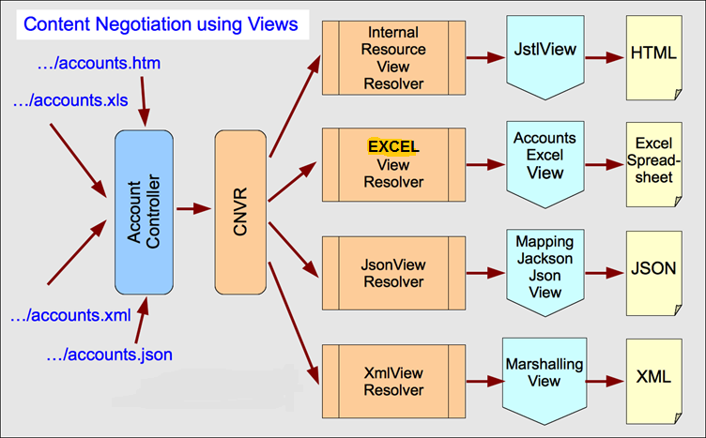
ContentNegotiatingViewResolver
Scenario based on “file extension” in URL:
Single Controller method..multiple views…
CNVR
Notes:
DEMOS:
Webstore9
Mvc-content-neg-views uses: ContentNegotiationManagerFactoryBean
Manager is for setting strategies…
EXAMPLE disables header; sets mapping for params [mediatypes]

Slide 7
Resolving Image files for uploading
HTTP multipart request is used by browsers to upload files/data to the server
Spring good support HTTP multipart request:
  CommonsMultipartResolver
  DispatcherServlet XML config:
<bean id="multipartResolver" class="org.springframework.web.multipart.commons.CommonsMultipartResolver">
<property name="maxUploadSize" value="10240000"/>
</bean>
JSP:
<form:form modelAttribute="newProduct" class="form-horizontal"
enctype="multipart/form-data">
<form:input id="productImage" path="productImage" type="file"
class="form:input-large" />
Content-Type: multipart/form-data
Notes:
All files are binary even if they should only contain text. application/x-www-form-urlencoded is the standard way to POST a form without attached files. multipart/form-data is the standard way to POST a form with attached file(s). (There are also numerous other encodings, such as application/json
HTTP HEADER _ Content-Type: multipart/form-data;

Slide 8
Resolving Image files for uploading[Cont.]
Saving image in Controller:
MultipartFile productImage = productToBeAdded.getProductImage();
String rootDirectory = servletContext.getRealPath("/");
if (productImage!=null && !productImage.isEmpty()) {
try {
File outputfile =
new File(rootDirectory+"\\resources\\images\\"
+ newProduct.getProductId() + ".png");
BufferedImage bufferedImage = ImageIO.read(productImage.getInputStream());
ImageIO.write(bufferedImage, "PNG", outputfile);
} catch (Exception e) {
throw new RuntimeException("Product Image saving failed", e);
rootDirectory == application root on Server
Notes:
Show image on server…
Getting file extension doesn’t get you file type [ e.g. an .exe with a .doc extension]
Get content type…from MultiplpartFile….
Try Uploading readmex.gif in lesson 7 demo area [notepad file renamed as gif]
Content type printed on console
CAN ALSO RESTRICT FILE TYPES:
property name="restrictFileTypes" value="pdf"/--> BY file EXTENSION

Slide 9
Main Point
Spring MVC Views and View Resolvers offers a variety of ways to manage the presentation of data.
Life is the expression of the field of all possibilities resulting in an explosion of variety in nature

Slide 10
Handler Exception Resolver
HandlerExceptionResolver interface
  Used to resolve exceptions during Controller mapping & execution
  Two Default implementations [”out of the box”]:
    ResponseStatusExceptionResolver – supports @ResponseStatus
    ExceptionHandlerExceptionResolver – supports @ExceptionHandler
  Exceptions can be handled EITHER individually OR Globally across ALL Controllers with @ControllerAdvice

Slide 11
ResponseStatusExceptionResolver
Marks a method or exception class with the status code and reason that should be returned. “Customizes” exceptions as HTTP status codes
The status code is applied to the HTTP response when the handler method is invoked, or whenever said exception is thrown.
Could reside on Exception OR in @ControllerAdvice
@ResponseStatus Example Generates a 404 message:
@ResponseStatus(value=HttpStatus.NOT_FOUND,
reason="No products found under this category")
public class NoProductsFoundUnderCategoryException extends RuntimeException{
ProductController “Test”:
if (products == null || products.isEmpty()) {
throw new NoProductsFoundUnderCategoryException();
}

Slide 12
ExceptionHandlerExceptionResolver
Method identified as ExceptionHandler for exception resolution
Could reside in EITHER ProductController OR @ControllerAdvice
@ExceptionHandler(ProductNotFoundException.class)
public ModelAndView handleError(HttpServletRequest req, ProductNotFoundException exception) {
ModelAndView mav = new ModelAndView();
mav.addObject("invalidProductId", exception.getFullMessage());
mav.setViewName("productNotFound");
return mav;
}
JSP: productNotFound.jsp
<h1 class="alert alert-danger"> ${invalidProductId}</h1>

Slide 13
Product Not Found Exception
public class ProductNotFoundException extends RuntimeException{
private String message = "No product found with the product ID = ";
private String productId;
public ProductNotFoundException(String productId, String message) {
    this.productId = productId;
    if (message != null) this.message = message;
}
public String getFullMessage() {
return (message + productId);
}
public String getProductId() {
return productId;
}

Slide 14
@ControllerAdvice
Indicates the annotated class assists a "Controller“
Works across ALL controllers
It is typically used to define @ExceptionHandler, @InitBinder, and @ModelAttribute methods that apply to all @RequestMapping methods.
@ControllerAdvice
public class ControllerExceptionHandler {
Handles exceptions….

Slide 15
Demo: Test Exception
Product Controller “dummy” URL:
@RequestMapping(value = "/throw", method = RequestMethod.GET)
public String throwException(@ModelAttribute("newProduct") Product newProduct) {
String productId = "B1234";
Product product = productService.getProductById(productId);
if(product == null) {
throw new ProductNotFoundException(productId, null);
}

Slide 16
Main Point
A well-defined exception and error handling approach is important for simplifying the development of web applications.
The removal of obstacles is an important aspect of the process of growth.

Slide 17
Internationalization
i18n – ‘i’+ 18 chars + ‘n’ == internationalization
Support for multiple languages & data format with code rewrite
Examples:
    zh Chinese nl Dutch
    hi Hindi el Greek
    ja Japanese fr French
L10n = ‘I’+10 chars + ‘n’ = localization
Support locale-specific [geographic/region/country] information
    Egypt EG Libya LY China CN
    India IN Taiwan TW
  Mynmar MM Mongolia MN

Slide 18
Java Locale class
Locale(String language)
Locale(String language, String Country)
Locale(String language, String Country, String variant)
Variant is browser specific code [windows, MAC, etc.]
Message are stored in “.properties files indicating Locale
E.g. messages_zh.properties
Optionally messages_zh_CN.properties
Notes:
https://shunchaowang.wordpress.com/2015/04/01/spring-mvc-utf-8-encoding/
Resource Bundle plugin
get into the habit of always specifying an encoding when reading and writing text files….
You shouldn't put the Czech characters in but there encoded form ie \u2349 instead of the actual output.
## Set eclipse preferences - general - add content type for text -
##file association *.properties default encoding UTF-8
<!-- Recognize unicode characters on web page... --> web.xml

Slide 19
Locale Resolvers
Browser’s Accept-Language header
<bean id="localeResolver" class="org.springframework.web.servlet.i18n.AcceptHeaderLocaleResolver">
<property name="defaultLocale" value="en_US"/>
</bean>
Session
  uses a locale attribute in the user's session
<bean id="localeResolver"
class="org.springframework.web.servlet.i18n.SessionLocaleResolver">
<property name="defaultLocale" value="en_US"/>
</bean>
Cookie
  uses a cookie sent back to the user
bean id="localeResolver"
class="org.springframework.web.servlet.i18n.CookieLocaleResolver">
<property name="defaultLocale" value="en_US"/>
</bean>
Notes:
FF – options /Content/languages/choose

Slide 20
LocaleChangeInterceptor
Used to handle Cookie or Session locale resolvers AUTOMATICALLY
<mvc:interceptors>
<bean class= "org.springframework.web.servlet.i18n.LocaleChangeInterceptor">
<property name="paramName" value="language"/>
</bean>
</mvc:interceptors>
This is the parameter that the interceptor looks for...

Slide 21
Tiles
Composite View Pattern
create pages using a consistent structure
pages share the same layout
individual pages differ in segments
segment placement maintains positional consistency
across all the site.
Notes:
https://spring.io/blog/2012/10/30/spring-mvc-from-jsp-and-tiles-to-thymeleaf/
Good examples…
https://tiles.apache.org/2.1/framework/tutorial/pattern.html --- composite vs decorator
https://tiles.apache.org/framework/tutorial/advanced/wildcard.html
PREFIXES???
http://tech.finn.no/2012/07/25/the-ultimate-view-tiles-3/

Slide 22
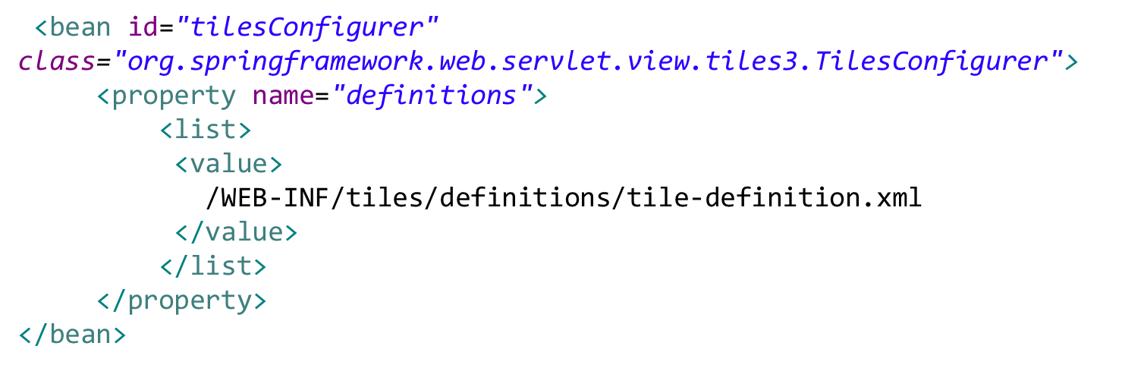
Tiles View Resolver
Configuration
<bean id="tilesViewResolver"
class="org.springframework.web.servlet.view.UrlBasedViewResolver">
<property name="viewClass"
value="org.springframework.web.servlet.view.tiles3.TilesView" />
<property name="order" value="-2" />
</bean>

Slide 23
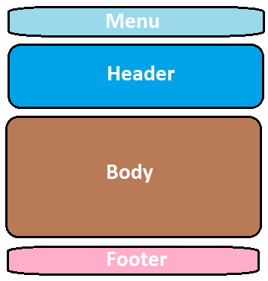
Sample Template [layoutTemplate.jsp ]
<title><tiles:insertAttribute name="title" /> <body>
<ul class="nav nav-pills pull-right">
<tiles:insertAttribute name=“menu" />
</ul>
<h3 class="text-muted">Web Store</h3>
<h1>
<tiles:insertAttribute name="header" />
</h1>
<p>
<tiles:insertAttribute name="subHeader" />
</p>
<div class="row">
<tiles:insertAttribute name=“body" />
</div>
<div class="footer">
<tiles:insertAttribute name="footer" />
</div>
</body>

Slide 24
Example Tiles Definition File
Takes template file & “initializes” it
Sets up navigation bar & footer
<tiles-definitions>
<definition name="baseLayout"
template="/WEB-INF/tiles/template/layoutTemplate.jsp">
<put-attribute name="title" value="Sample Title" />
<put-attribute name=“menu"
value="/WEB-INF/tiles/template/navigation.jsp" />
<put-attribute name="header" value="" />
<put-attribute name="subHeader" value="" />
<put-attribute name=“body" value="" />
<put-attribute name="footer"
value="/WEB-INF/tiles/template/footer.jsp" />
</definition>

Slide 25
Example Tiles Pages
Welcome Page details
<definition name="welcome" extends="baseLayout">
<put-attribute name="title" value="Welcome" />
<put-attribute name="header" value="Internationalization" />
<put-attribute name=“body" value="/WEB-INF/views/welcome.jsp" />
</definition>
Products Page details
<definition name="products" extends="baseLayout">
<put-attribute name="title" value="Products" />
<put-attribute name="header" value="Products" />
<put-attribute name=“subHeader" value="Available Products" />
<put-attribute name=“body" value="/WEB-INF/views/products.jsp" />
</definition>

Slide 26
Tiles Challenge: definition per page
Adding a new page requires a new definition in the
tile-definition.xml file
<definition name="welcome" extends="baseLayout">
<definition name="products" extends="baseLayout">
<definition name="product" extends="baseLayout">
<definition name="addProduct" extends="baseLayout">
<definition name="login" extends="baseLayout">
<definition name="cart" extends="baseLayout">
etc., etc., etc...

Slide 27
Solution: Tile Wildcards
<!– This Wild Card works for multiple controller JSP references...
<definition name="*/*" extends="baseLayout">
<put-attribute name="title" value="{2}.title" />
<put-attribute name="heading" value="{2}.heading" />
<put-attribute name="tagline" value="{2}.tagline" />
<put-attribute name="body" value="/WEB-INF/views/{1}/{2}.jsp" />
</definition>
ALSO in LayoutTemplate we can access attribute value
<c:set var="heading"><tiles:getAsString name="heading" /></c:set>
Property file references
AND externalize the contents
Converts attribute value to a String
<spring:message code="${heading}"/>

Slide 28
Wildcard matches
Controller JSP name matches with wildcard in definition
<definition name="*" extends="baseLayout">
return "welcome";
<definition name="*/*" extends="baseLayout">
return "/welcome";
return “product/product";
<definition name="*/*/*" extends="baseLayout">
return "/welcome/";
return "/welcome/foo";
Notes:
Where first * is null; 2nd * is welcome; 3^{rd *} is null [ or foo]

Slide 29
Main Point
All good websites have something in common: they have an organized look & feel.
A facet of SCI is that Order is found everywhere

